Slide 1
Digital Portfolio
STUDENT NAME: Hema Kumar T
REGISTER NO AND NMID:astvu30230224u18011
DEPARTMENT: B(SC)CS
COLLEGE: COLLEGE/ UNIVERSITY ARAKKONAM ARTS AND SCIENCE COLLEGE THIRUVALLUVAR UNIVERSITY

Slide 2
PROJECT TITLE
project title name Hemakumar
work details

Slide 3


AGENDA
Problem Statement
Project Overview
End Users
Tools and Technologies
Portfolio design and Layout
Features and Functionality
Results and Screenshots
Conclusion
Github Link
3/21/2024 Annual Review

Slide 4

PROBLEM STATEMENT
A problem statement is a statement of a current issue or problem thar requires timely action to
Improve the situation
This statement concisely explains the barrier the current problem places between functional
Process and or product and the current problematic state of affirs6

Slide 5

PROJECT OVERVIEW
The project overview is work and contact details all

Slide 6

WHO ARE THE END USERS?
All guys is used to project
Students
Job seekers
Freelancers
professionals

Slide 7

TOOLS AND TECHNIQUES
HTML Structure (pages,sections)
CSS styling (colors,layouts,responsiveness)
JavaScript Interactivi(navigation mean,animations,form validation)
Mention code editor(vs code) or mobile responsible github pages

Slide 8
POTFOLIO DESIGN AND LAYOUT
HOME PAGE
HTML ->Header (title digital portfolio font size font family h1 margin left image right ) ,Main Section (nav div class), JavaScript Function(click button contact submit gender email)
Mobile View (with my added CSS) -> Header ((title digital portfolio font size font family h1 margin left image right ) ,Main Section (nav div class), JavaScript Function(click button contact submit gender email)
8

Slide 9
FEATURES AND FUNCTIONALITY
HOME PAGE
HTML ->Header (title digital portfolio font size font family h1 margin left image right ) ,Main Section (nav div class), JavaScript Function(click button contact submit gender email)
Mobile View (with my added CSS) -> Header ((title digital portfolio font size font family h1 margin left image right ) ,Main Section (nav div class), JavaScript Function(click button contact submit gender email)

Slide 10
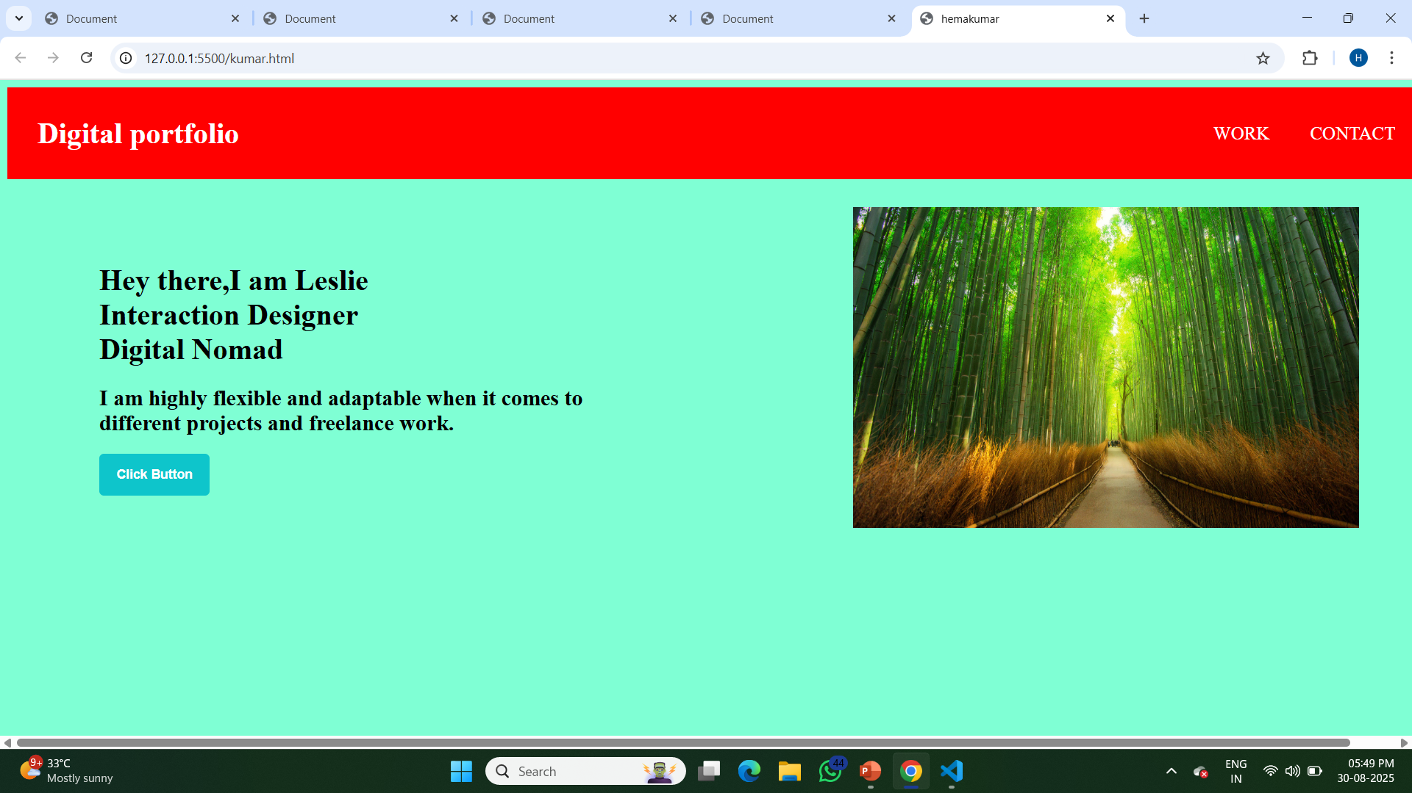
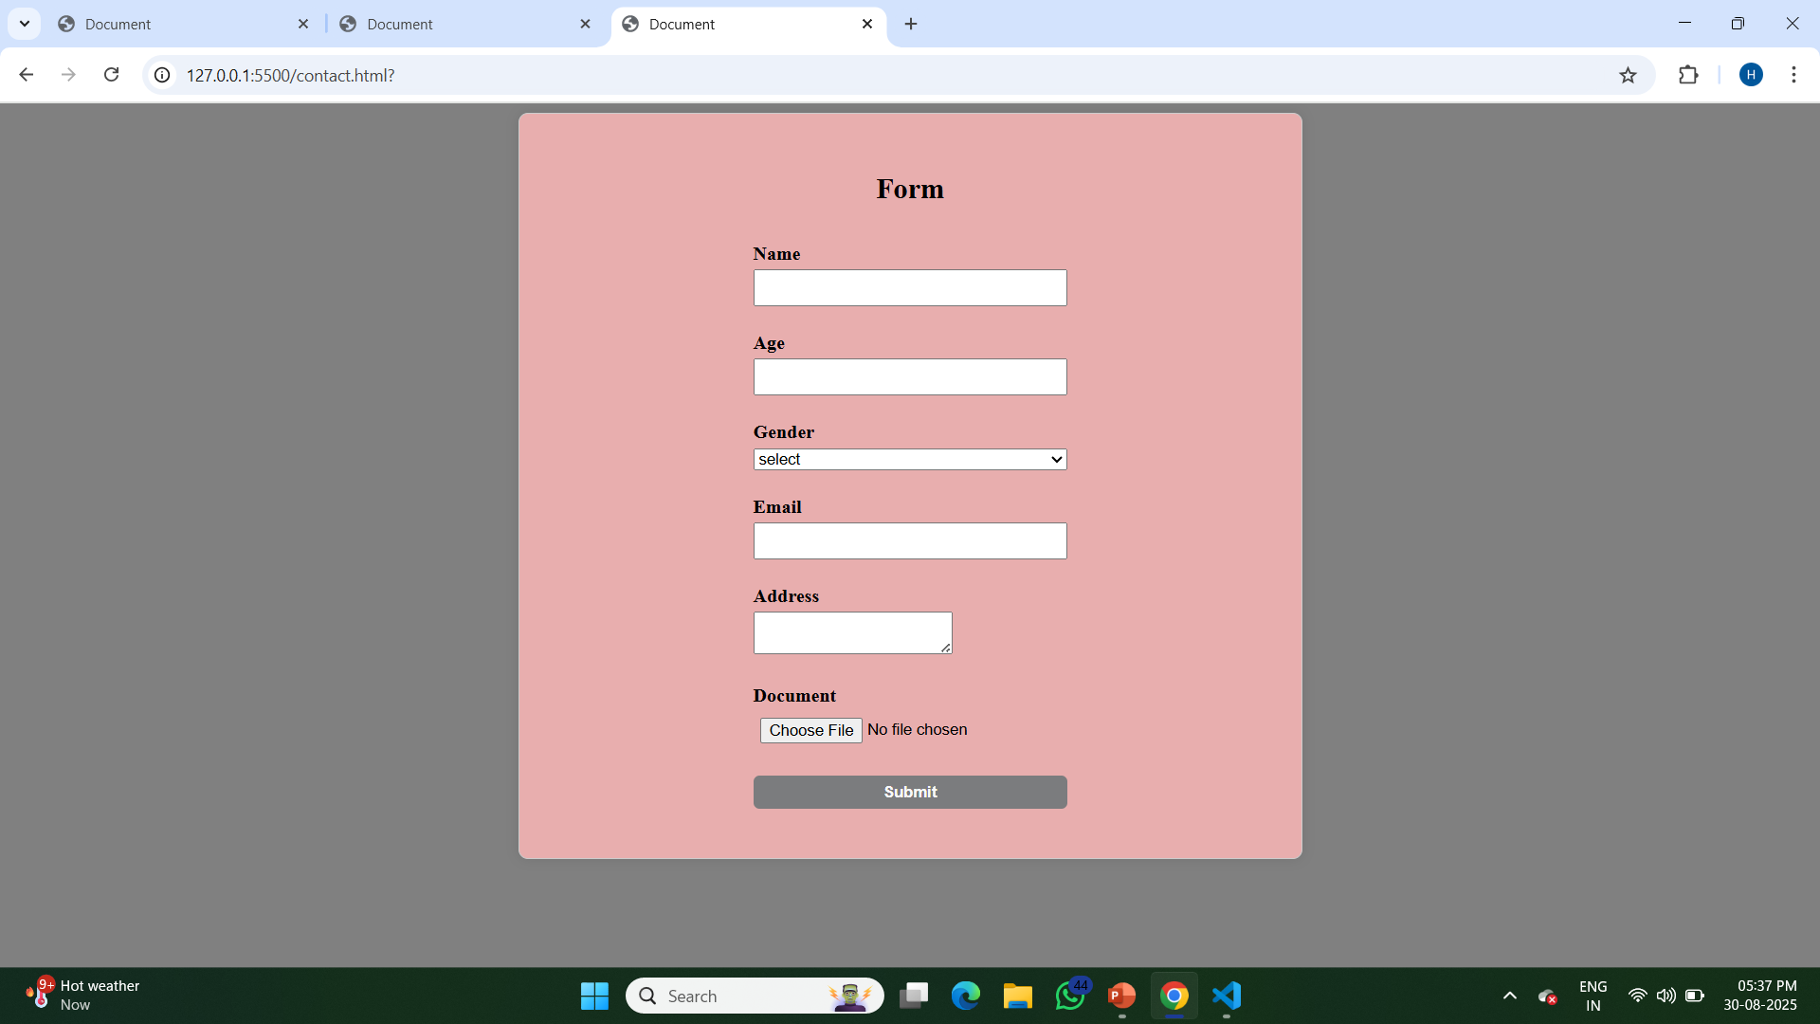
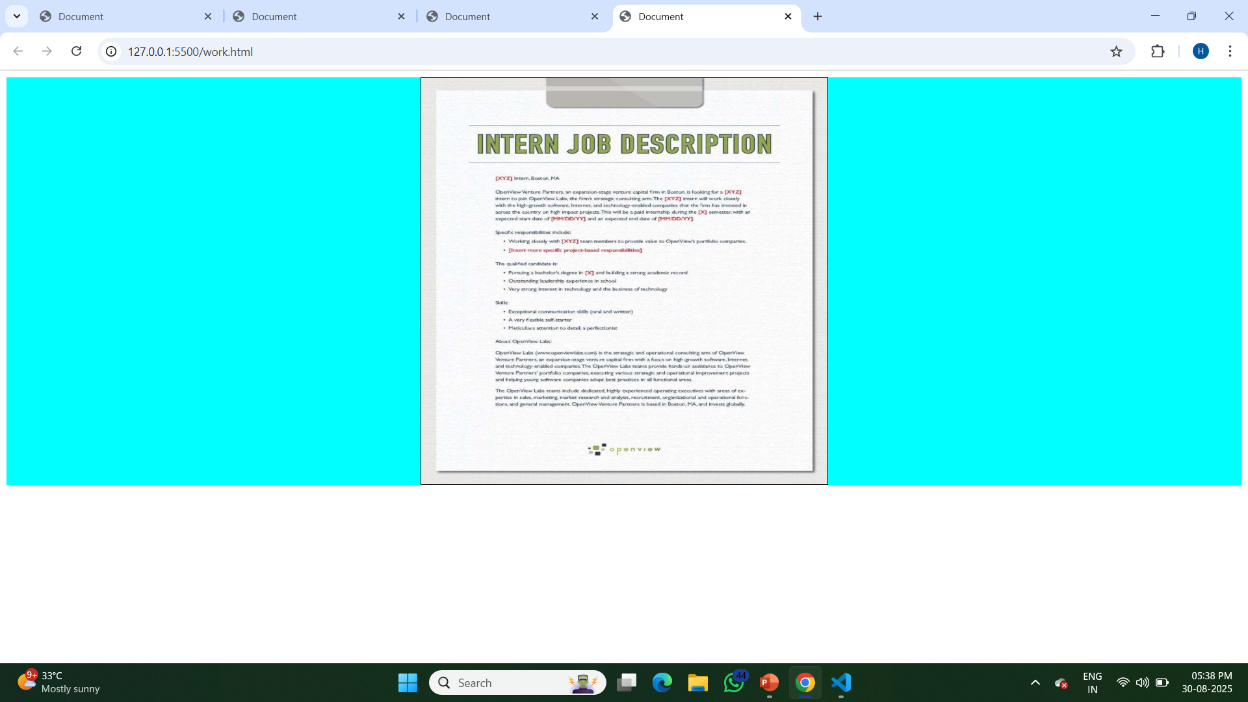
RESULTS AND SCREENSHOTS
3/21/2024 Annual Review
10

Slide 11
CONCLUSION
HOME PAGE
HTML ->Header (title digital portfolio font size font family h1 margin left image right ) ,Main Section (nav div class), JavaScript Function(click button contact submit gender email)
Mobile View (with my added CSS) -> Header ((title digital portfolio font size font family h1 margin left image right ) ,Main Section (nav div class), JavaScript Function(click button contact submit gender email)
Next page move job details next page move contact details
11

